Slide 1
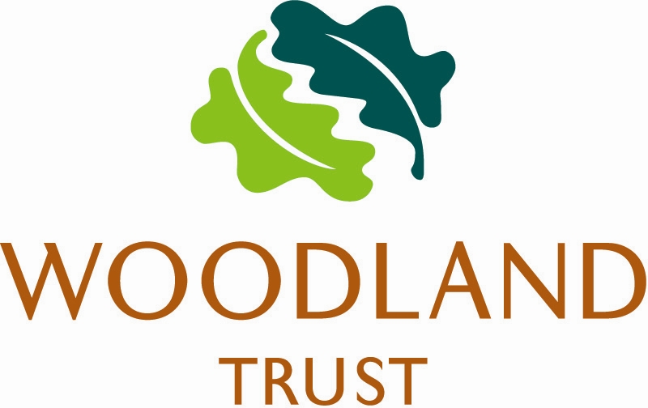
Woodland Restoration
With support from the Woodland Trust, we are working to improve biodiversity in Moat Wood. The aim is to make it as diverse and resilient as possible by reducing a proportion of shady non-native conifers such as Douglas Fir. These species grow quickly and out-compete our native trees, shrubs and ground flora, blocking the light and space they need to grow. They also provide limited habitat for wildlife.
The woodland will look different once the works are finished, but with time the increased availability of light and other resources will enable valuable native species to grow and in turn encourage more wildlife to make Moat Wood their home.

